Slide 1
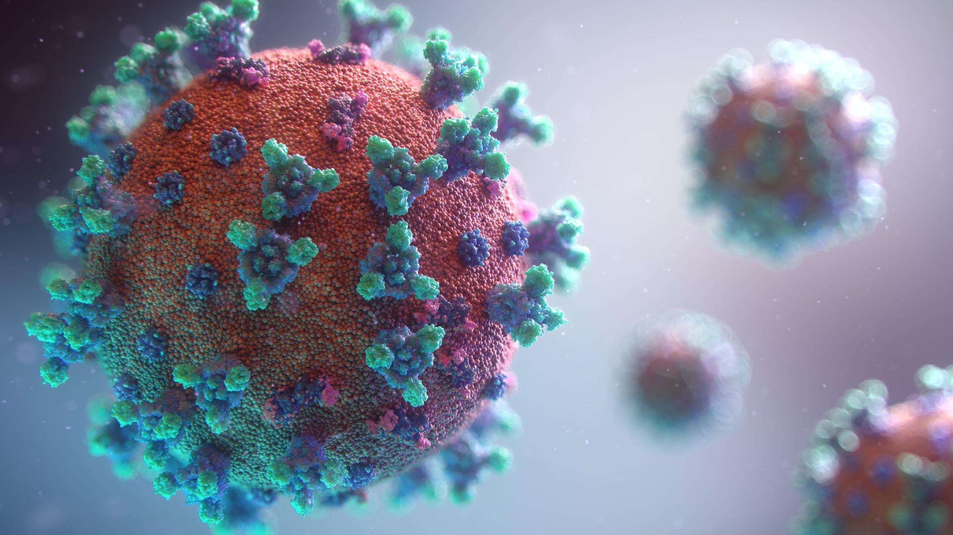
Detecting COVID-19 from X-Ray Images
September 16, 2021
Andrea Leitereg
Tamilselvan Tamilmani

Slide 2
Problem
How can x-ray images be used to accurately detect COVID-19?
Hypothesis
Can we apply deep learning techniques to accurately detect COVID-19 in x-ray images?
Notes:
By now, we all know that testing is critical for controlling any pandemic, including our current COVID-19 pandemic.
However, in places where PCR swab tests have limited availability, it is critical that there be an accurate alternative.
We wanted to explore whether medical imaging could be a viable alternative for the traditional COVID-19 testing methods.
Chest x-rays are already the best way to diagnose pneumonia, so it could also yield good results for COVID-19.
If X-ray is viable in terms of accuracy, it has additional benefit as a cost effective option because the infrastructure is already set up.
Problem: Can we identify COVID-19 using x-ray images?
Hypothesis: We can apply deep learning techniques to accurately detect COVID-19.

Slide 3
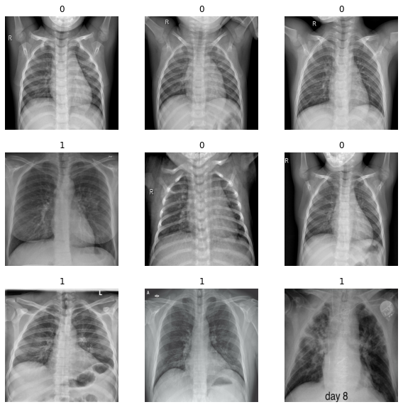
The Data
Lung x-ray images
196 images of COVID-19 positive patients & 196 images of negative patients
Average training normal image size: 1600x1300 pixels
Average training COVID-19 image size: 1300x1200 pixels
Notes:
Data was obtained via Kaggle and already labeled with positive or normal and arranged into Test and Train folders.

Slide 4
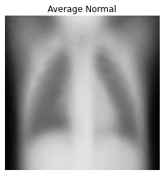
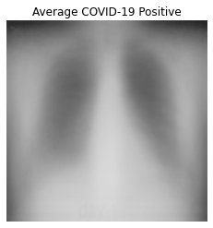
Averages
Normal
Positive
Notes:
We took the average pixel values across all normal lung x-ray images and all covid-19 positive lung x-ray images.
Here are what the average images look like for a normal lung x-ray and a covid-19 positive lung x-ray.
The normal lung looks much clearer, while the covid-19 positive lung is much blurrier.
This is likely the inflammation caused by infection.
Articles describe COVID-19 having a “frosted glass-like” appearance on the lung in imaging.

Slide 5
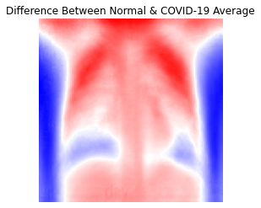
Differences Between Averages
Notes:
More color saturation = greater differences between the two
Darker red = higher pixel value in normal lung
Darker blue = higher pixel value in covid-19 lung
White = similarities
Likely more inflammation from COVID-19 present in the lower lungs

Slide 6
Analysis

Slide 7
Training Setup
Holdout Test
Evaluation Metric
Problem Scope
Resource
80/20 split for Training and Validation. Separate Test set
Binary Accuracy, since the data set is well balanced.
16 CPU, 30 GB, TESLA T4 GPU
Binary Classification

Slide 8
Models
Image Resized to 500x500 and Normalized
 |  | Accuracy
ID | Type | Training | Validation | Test | Train-Test
CNN1 | NN with 1 Convolution Layer | 98.44% | 98.44% | 94.44% | 4.00%
CNN2 | CNN1 with Image Pre Processing | 99.61% | 98.44% | 95.83% | 3.78%
CNN3 | CNN2 with 2 Convolution Layer | 100.00% | 100.00% | 98.61% | 1.39%
CNN4 | CNN2 with 3 convolution layer | 98.83% | 98.44% | 97.22% | 1.61%
CNN5 | CNN3 with Grid Search (30 Models) | 100.00% | 100.00% | 97.22% | 2.78%
CNN6 | Transfer Learning with ImageNetv2 | 78.00% | 76.00% | 50.00% | 28.00%
CNN7 | Transfer Learning with VGG19 | 87.50% | 95.31% | 94.44% | 6.94%
CNN7 | Transfer Learning with DenseNet121 | 99.22% | 100.00% | 98.61% | 0.61%
Notes:
We just started with NN, since it’s better for image classification
Feature Engineering - Image normalization, 500x500 image resize

Slide 9
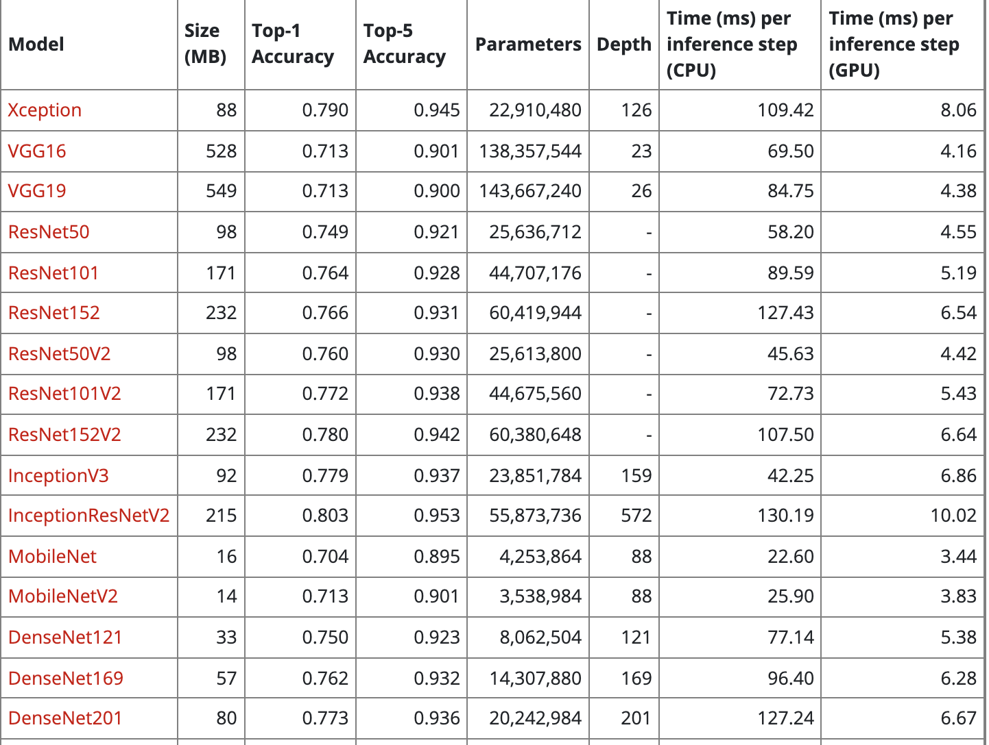
Base Models

Slide 10
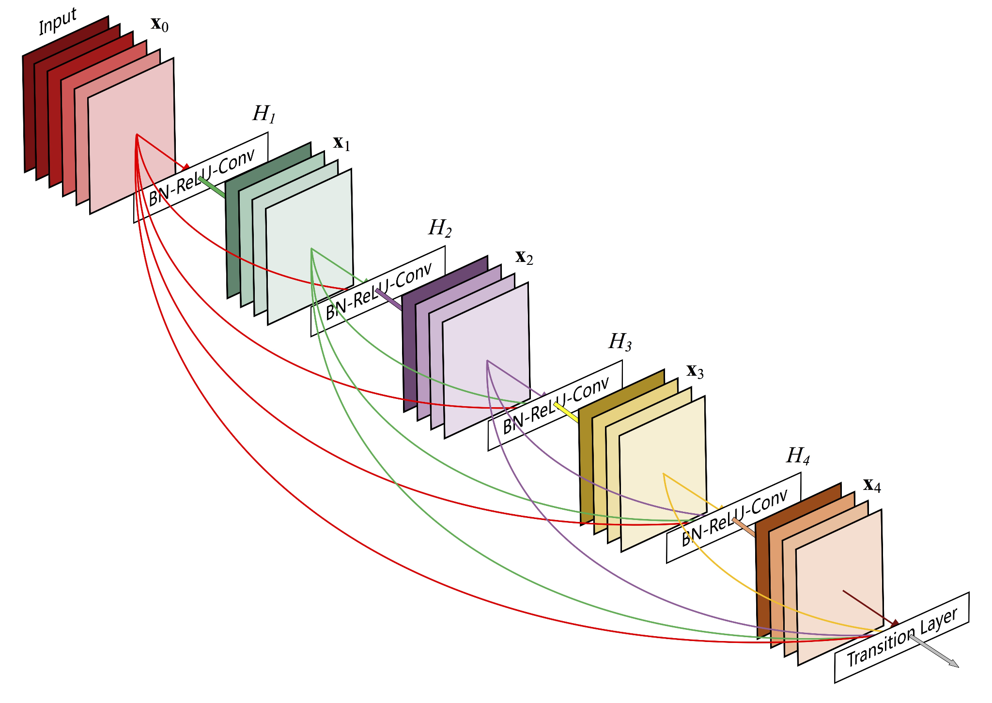
Dense CNN
Dense Convolutional Network (DenseNet), which connects each layer to every other layer in a feed-forward fashion. Whereas traditional convolutional networks with L layers have L connections - one between each layer and its subsequent layer - our network has L(L+1)/2 direct connections. For each layer, the feature-maps of all preceding layers are used as inputs, and its own feature-maps are used as inputs into all subsequent layers.
DenseNets have several compelling advantages: they alleviate the vanishing-gradient problem, strengthen feature propagation, encourage feature reuse, and substantially reduce the number of parameters

Slide 11

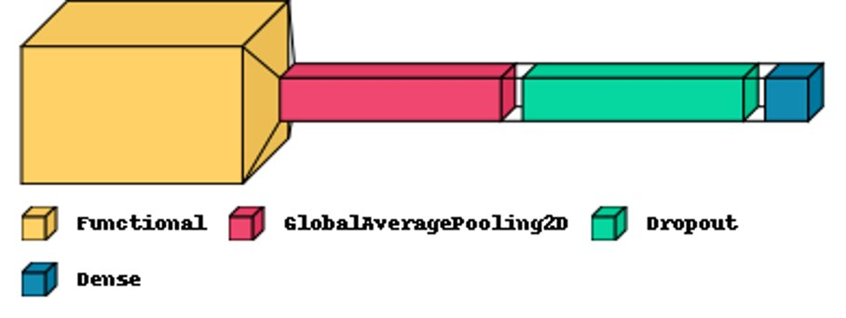
Final Model
Dense convolutional neural network with ImageNet weights
Transfer model has one pooling layer, one dropout, and one dense layers (Sigmoid for Binary)
Perfect accuracy
100%
Accuracy on test set
Notes:
Explain what types of analysis you used. Explain how you arrived at the model(s) you used for your recommendation.

Slide 12
Recommendations
DenseNet-based transfer learning model
Generalized well, minimal overfitting
Small model, can be productionized easily
Combine the image preprocessing and model in to easy to use, executable, so it can be deployed across world easily.

Slide 13
Thank you.

Slide 14
References
Data: https://www.kaggle.com/khushwantparihar/covid-detectionxray-images
https://towardsdatascience.com/exploratory-data-analysis-ideas-for-image-classification-d3fc6bbfb2d2
https://stanfordmlgroup.github.io/projects/chexnet/
https://arxiv.org/abs/1608.06993

Slide 15
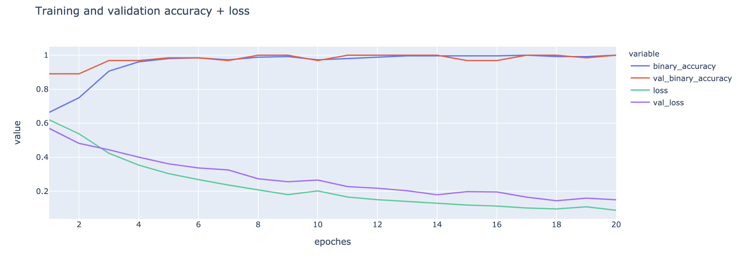
Training & Validation Metrics for DenseNet121 Transfer learning

